Slide 1
Intro to Qubits and Quantum Circuits
Chance Loveday
Next Generation Pathways
Oak Ridge Leadership Computing Facility (OLCF)
Oak Ridge National Laboratory (ORNL)
July 13, 2026

Slide 2
IQM Material
No Odo needed for this lesson.
Since we’re talking about quantum, today will be more conceptual.
If you would like to explore how to use IQM packages, such as Qcrip and Qiskit for scripting, check out IQM Resonance

Slide 3
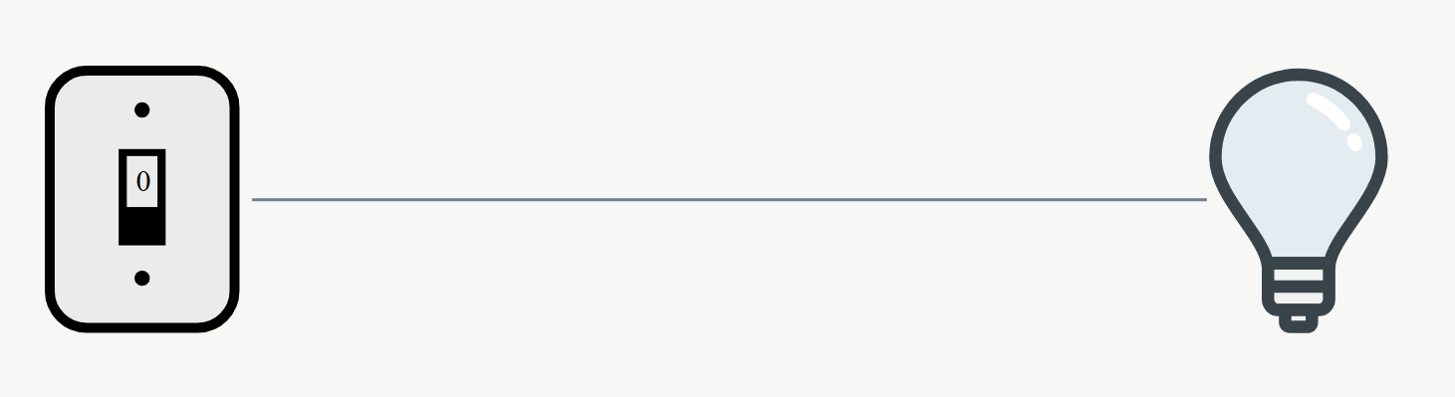
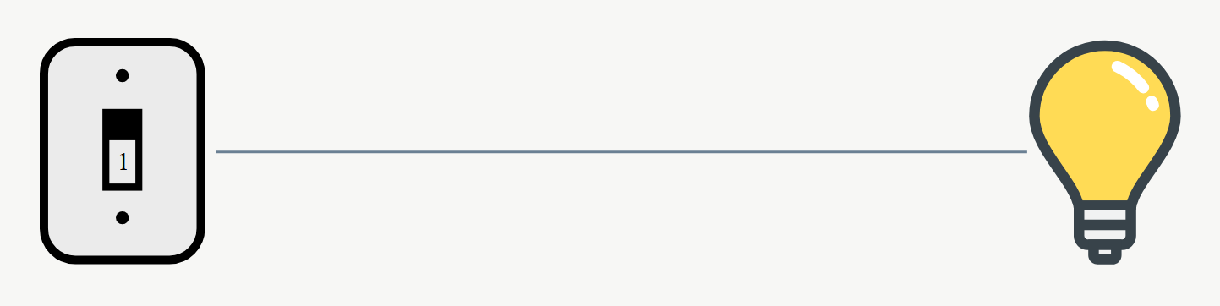
Classical Computing: What are Bits?
Bits are small binary objects in classical computers that make a single decision
Two possible states: 0 or 1
Ex. Your phone is either on (1) or off (0)
Each bit acts like a signal to the computer.
Composed of tiny transistors that turn on and off electrical signals
Think of bits like a switch turning on or off a lightbulb
Bit
Bit

Slide 4
Classical Computing: What are Bits?
Bits are the building blocks to everything you do on any computer, phone, etc.
They represent everything on your system, from adjusting volume to a YouTube video
They do this by applying operations via gates
Operating System
CPU
Arithmetic Logic Unit (ALU)
Multi-Gate Operations (e.g., Adders)
Single Logic Gates

Slide 5
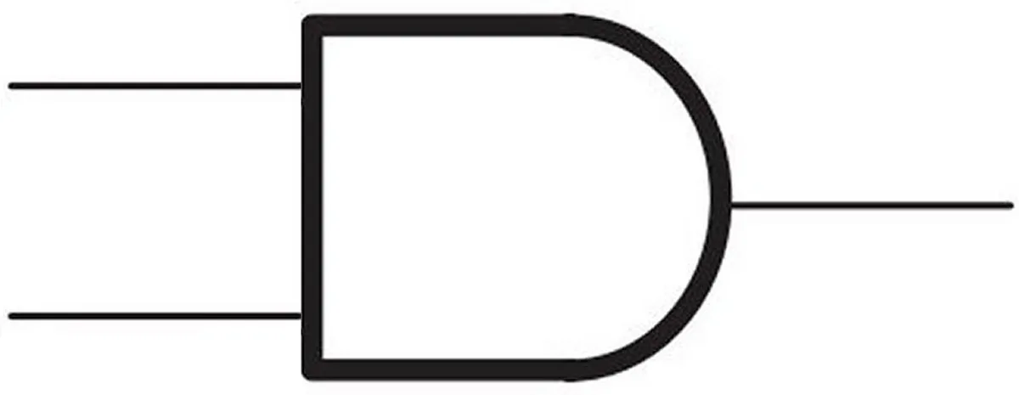
Classical Computing: Logic Gates
Computers apply operations to bits via gates.
These operations combine to form more complex actions
Simulation Link: https://circuitverse.org/simulator
Go back to thinking about light switches
AND

Slide 6
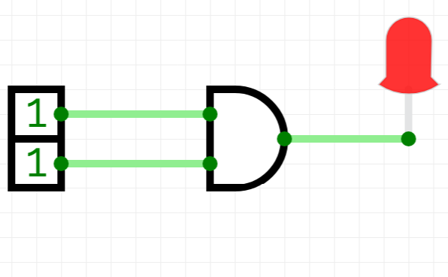
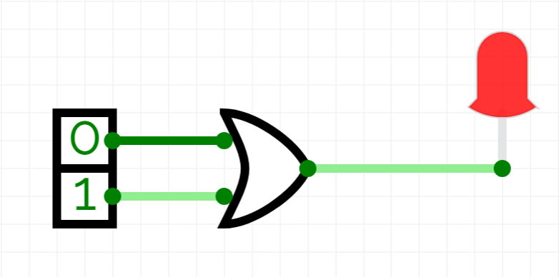
Classical Computing: AND & OR
AND
Both conditions need to be true
OR
Only 1 condition needs to be true

Slide 7
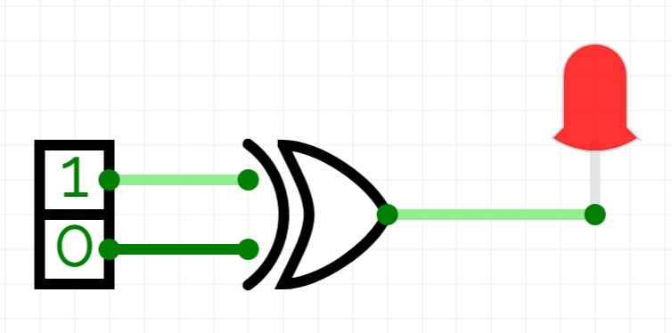
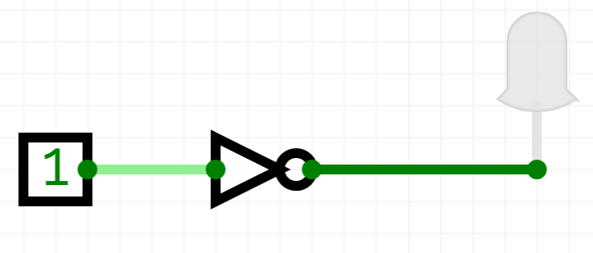
Classical Computing: XOR & NOT
XOR
1 condition must be true, 1 false
NOT
Negates condition

Slide 8
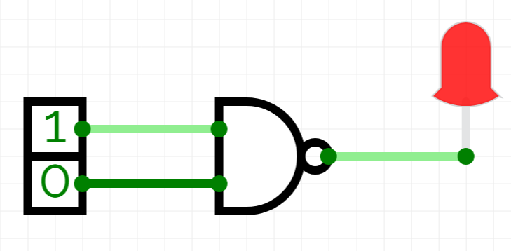
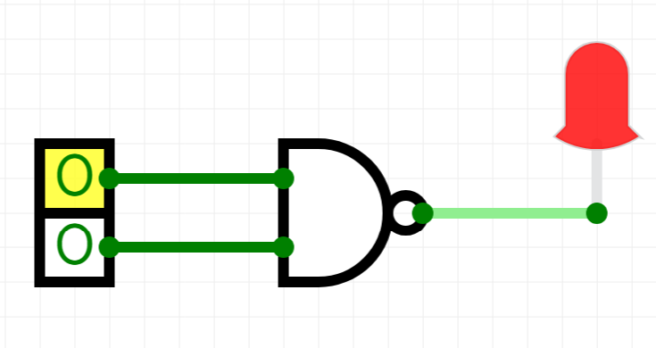
Classical Computing: NAND
NAND
True only if both conditions are false
Given the light is on, how can you determine the inputs?

Slide 9
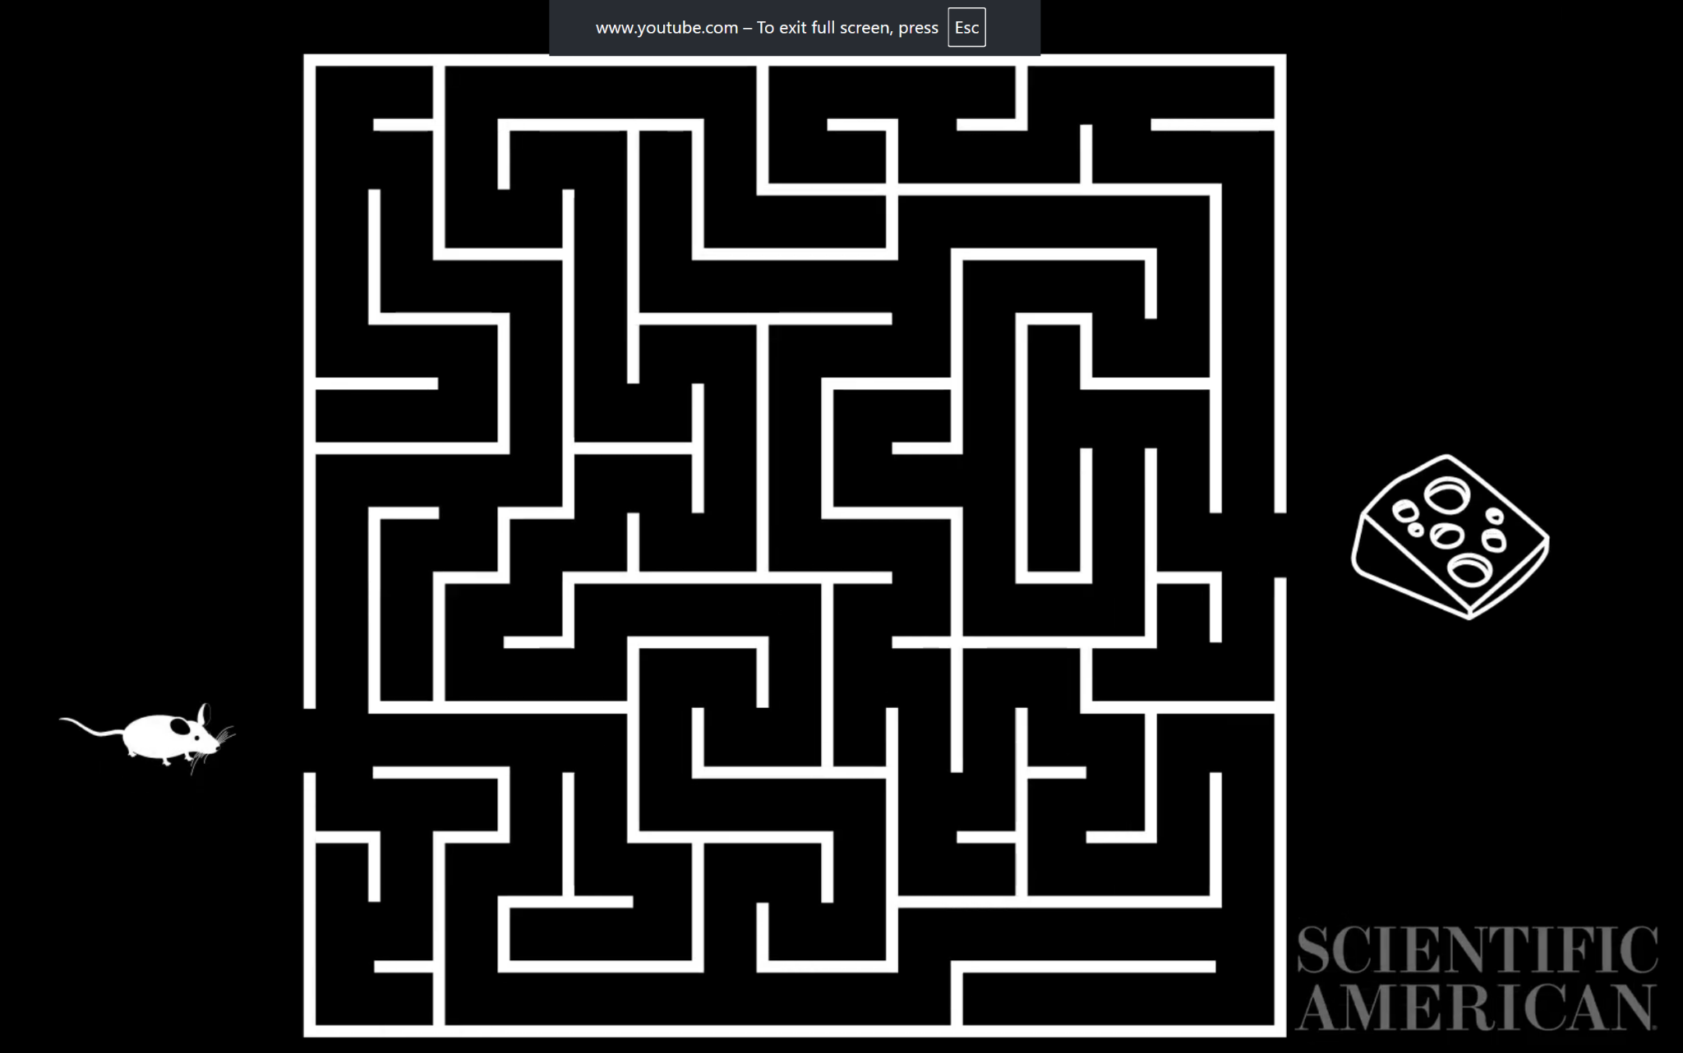
Enter Quantum Computing
Let’s look at how classical computing solves problems by looking at an example.
Let’s say the computer is a mouse, and the problem being solved is a maze
Classical Computing → Tries to escape the maze one path at a time and updating map
Quantum Computing → Considers all possible paths and explores the most probable ones first

Slide 10
Quantum Computing: Qubits
Classical computing isn’t suitable for all types of problems
It clearly becomes impractical for problems with an exponential number of potential solutions
Qubits
Qubits fill a similar role to bits, but it’s not as simple as two defined states
They can exist in a [linear] combination of two states (|0> and |1>)
This is known as superposition
However, qubit states rely on probabilities rather than certainty
After we observe a qubit’s state, we know the state it is in
When this happens, a qubit’s superposition collapses to the single state observed

Slide 11
Quantum Computing: Qubits
Let’s demonstrate a classic example called the Double-Slit Experiment
Traces back to 1801
Light shines through a barrier with two slits, which act as waves
When measuring the light from within the barrier, there was clearly interference
However, dim the light’s intensity until only one photon is traveling through the barrier at once. Interference was still found
→ As a result, this experiment gave substantial evidence to the theory of superposition

Slide 12
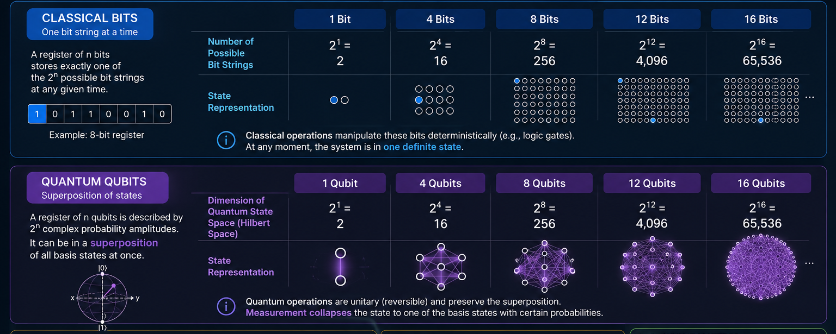
Quantum Computing: Qubits

Slide 13
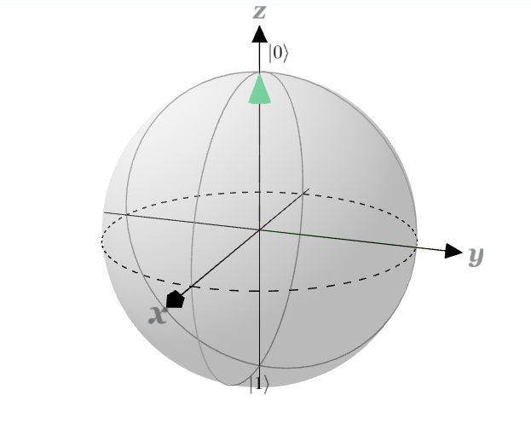
Quantum Computing: Bloch Sphere
Since qubits can exist at and between the states |0> and |1>, we need 3-dimensional way to represent a qubit’s state
Bloch Sphere Simulator: https://www.iqmacademy.com/play/bloch/
The Bloch sphere is a geometric representation of a qubit’s superposition
A qubit may be halfway between |0> and |1>, but orientation matters!
Every point on the sphere’s surface is a valid superposition
Notice that we use |0> and |1>, not 0 and 1
These are state vectors, specifically ket vectors (you’ve seen these before)

Slide 14
Quantum Gates: What’s the Difference?
All quantum gates have two properties:
All q-gate operations are reversible
Enable parallel computation (through manipulating superpositions)
Classical computers can theoretically run reversibly, but it’s disadvantageous

Slide 15
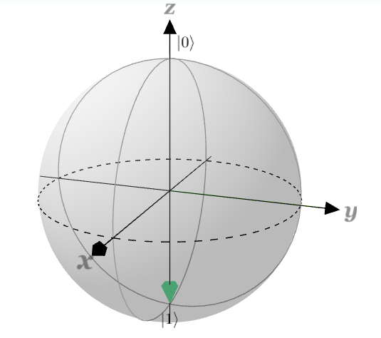
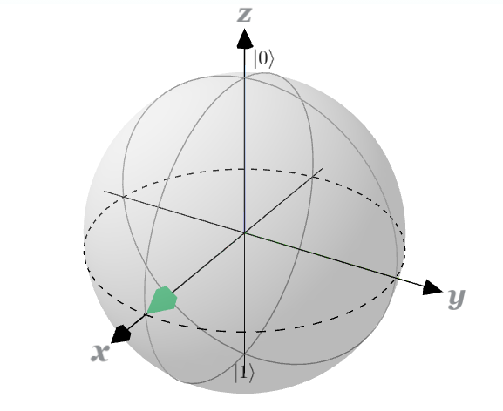
Quantum Gates: The X & Hadamard Gates
X Gate
Negates the current state
Bloch Sphere: 180° across x-axis
Ex: |0> → X → |1>
H Gate
Assigns an equal superposition of |0> and |1>
Bloch Sphere: 90° across y-axis
+
180° across x-axis
Ex: |0> → H → |+>
↻
↻
↻
X
H

Slide 16
Quantum Gates: The X & Hadamard Gates
H Gate
Special Property: After 2 H-gates, …
Bloch Sphere: 90° across y-axis
+
180° across x-axis
Resets to initial value
This happens for an even # of H-gates.
H
H

Slide 17

Quantum Gates: The X & Hadamard Gates

Slide 18
Quantum Gates: Pauli Gates
Pauli Gates: Gates that rotate 180° across an axis
Y Gate
Negates the current state like X gate
Bloch Sphere: 180° across y-axis
Ex: |0> → Y → |1>
Z Gate
Keeps the same state but negates the phase
Bloch Sphere: 180° across z-axis
Ex: |0> → Z → |0>
↻
↻
Y
Z

Slide 19
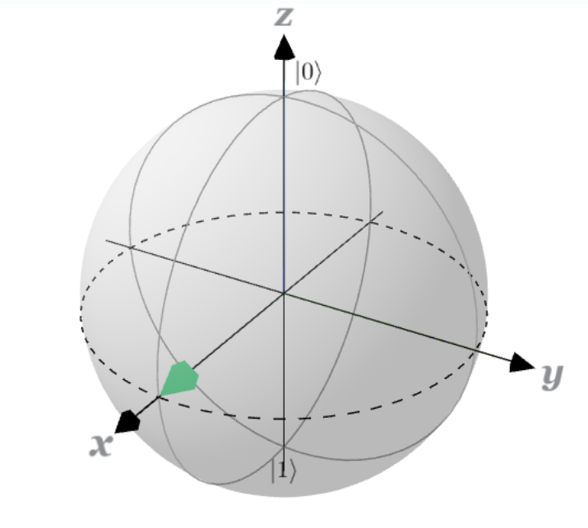
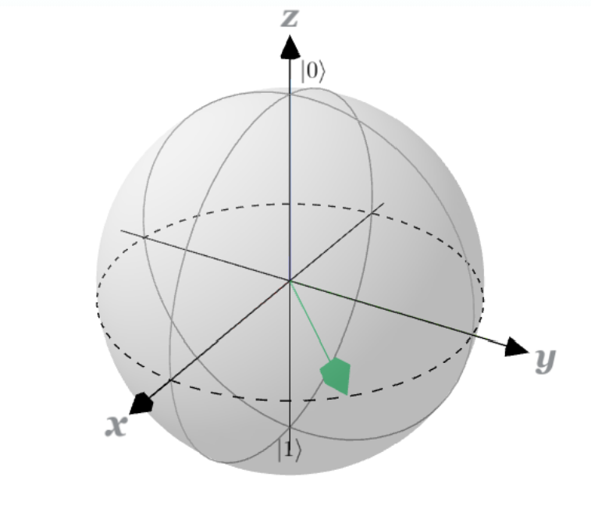
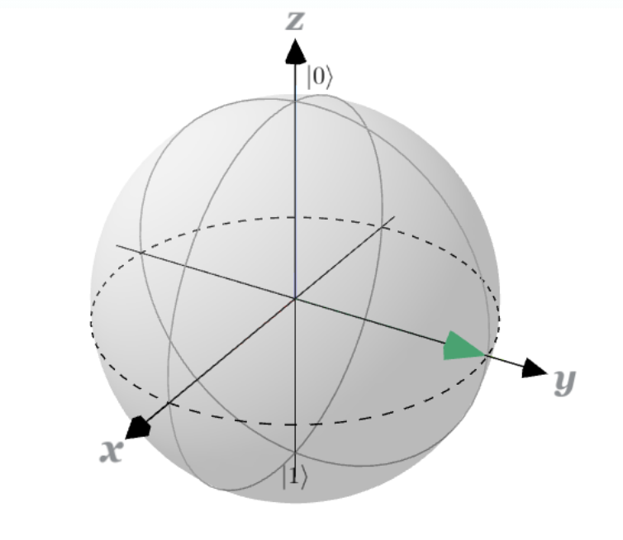
Quantum Gates: Phase Gates
Phase Gates: Smaller rotations across the z-axis
T Gate
1/4 x Z-gate
Bloch Sphere: 45° across z-axis
S Gate
1/2 x Z-gate
Bloch Sphere: 90° across z-axis
T
S

Slide 20
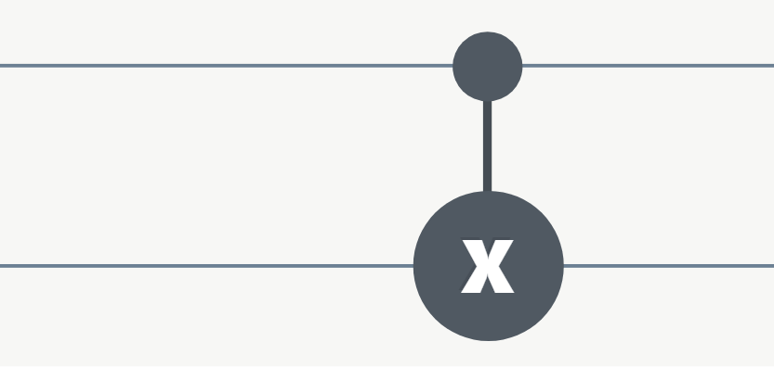
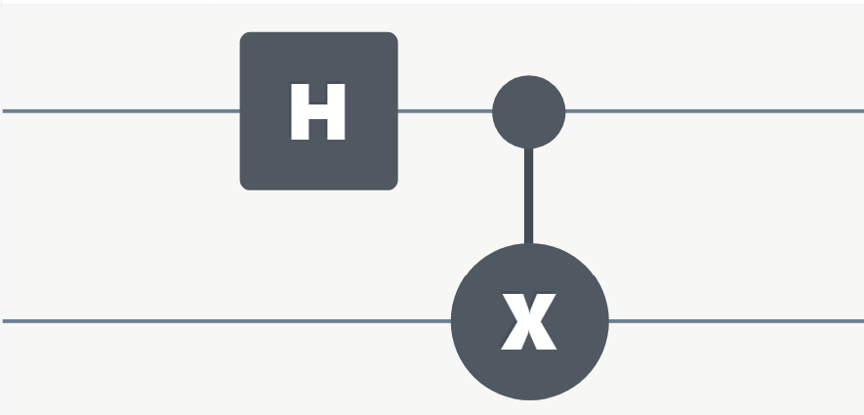
Quantum Circuits: CNOT
How do we handle multi-qubit gates in quantum?
Recall the NAND gate. The problem is that NAND has too many possible options to determine the inputs for every output.
To fix this concern, we use a controlled operation (CNOT)
→ CNOTs are one way to entangle qubits
CNOT
Uniform CNOT

Slide 21
Quantum Circuits: Entanglement
Measuring one entangled qubit immediately exposes information correlated to the other entangled qubit(s)
Remember superposition from earlier?
If we observe a qubit, the superposition collapses … and so does any entanglement with that qubit

Slide 22
Why Gates Matter
Universality
Some sets of gates are considered universal sets
In other words, they can form combinations to form all other gates
Note that since quantum gates are reversible, they save more informa tion
Classical Example
{OR, AND, NOT}
Quantum Example
{H, S, T, CNOT}
Both of these examples generate the remaining gates
Notes:
We could also discuss the idea of universal sets. These are sets composed of operations (works both for classical gates and quantum gates) that in combination can form all other states/gates. For example, NAND and NOR can generate equivalents to all other gates, so they form a universal set.

Slide 23
Why Qubits Matter
Allows for much more space to represent information
Quantum computing won’t replace classical computing/supercomputing … at least not for a while
Qubits and quantum computers aren’t fix-all solutions, but they will make certain problems drastically easier to address

Slide 24
Applications
Optimization through quantum algorithms
Modeling complex chemical structures
Speed up drug synthesis by more accurately modeling complex chemical interactions
Developing and Modeling new superconducting materials
Analyze cryptographic systems and motivate post-quantum security

Slide 25
Meet back here in 10 minutes

Slide 26
Qubits in Physical 3D Space
Chance Loveday
Next Generation Pathways
Oak Ridge Leadership Computing Facility (OLCF)
Oak Ridge National Laboratory (ORNL)
July 13, 2026

Slide 27
Qubits → Hardware
Qubits
Quantum Circuits
Quantum Algorithms
Compiler
But how do quantum computers achieve this?
Hardware
We’ve been treating gates as abstract boxes. Now, let’s open the box

Slide 28
Qubits: Theory Vs. Physical
We now know what a qubit is in theory, but how does it translate to hardware?
There are 3 prevailing models to represent physical qubits
Each model has its individual strengths and weaknesses
*Other models exist, but these are the frameworks for the current frontrunners
Superconducting Circuits
IBM, IQM, Google
(2) Trapped Ions
IonQ, Quantuum
(3) Neutral Atoms
CalTech’s QuEra

Slide 29





Qubits: Quantum Computers
Notes:
You probably recognize many if not all of these brands. They developed the current frontrunning computers in the quantum computing realm. Physical quantum computers do not have a well-defined architecture, and there are actually several experimental designs for quantum computers.

Slide 30
Qubits: Superconducting Circuits
Qubit: Tiny superconducting electrical circuit
Gates are controlled by: Microwave pulses
Operating Temp: 10-15 mK
Companies:

Slide 31

Qubits: Trapped Ions
Qubit: Encoded in highly stable energy levels of ions
Gates are controlled by: Precise lasers
Operating Temp: Room temperature in a vacuum-sealed chamber
Companies:

Slide 32

Qubits: Neutral Atoms
Qubit: Encoded within physical energy levels of electrons of trapped uncharged atoms held by ‘optical tweezers’
Gates are controlled by: Precise lasers
Operating Temp: Ultracold → Below 1 mK
Companies:

Slide 33
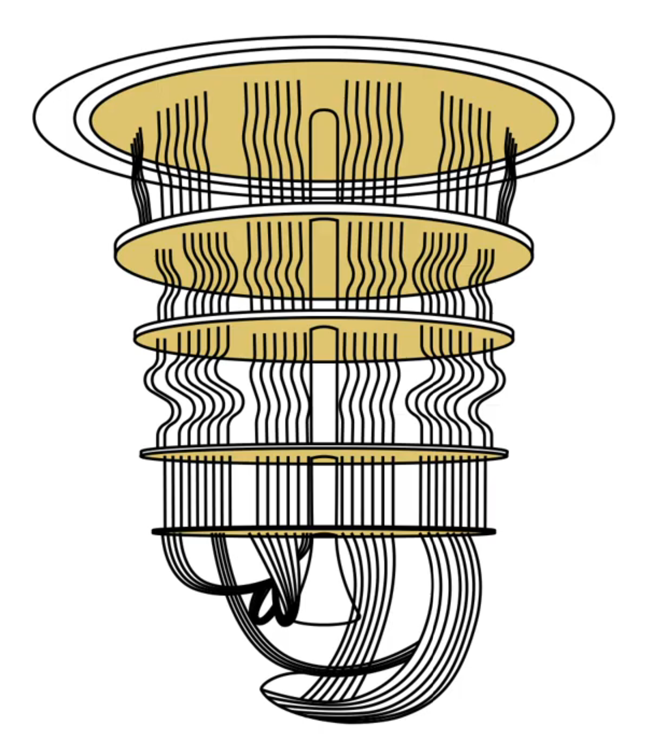
Hardware: Quantum Computer Anatomy I
As we just discussed, there are several designs for building a quantum computer
This is the general abstraction for a quantum computer using the superconductive circuit model
Chandelier = Subzero Refrigerator
Circuitry surrounding a core
Gold plates separating each layer that narrow as the deeper you go

Slide 34
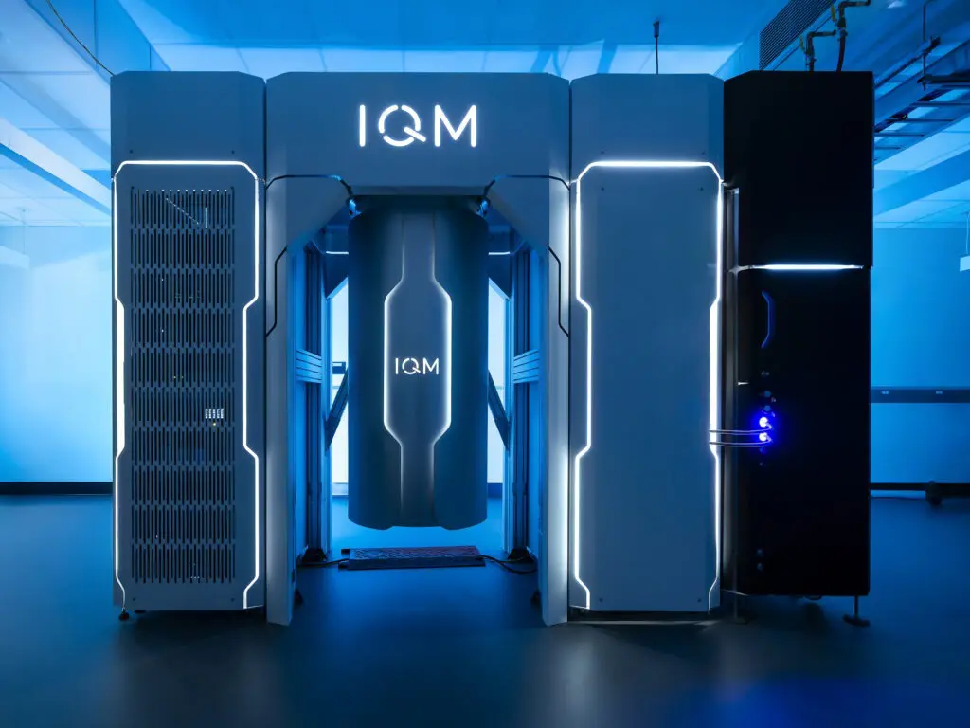
Hardware: Quantum Computer Anatomy II
Let’s look at one computer in particular
Why not use this as a chance to explore ORNL’s recently launched Pathfinder?

Slide 35
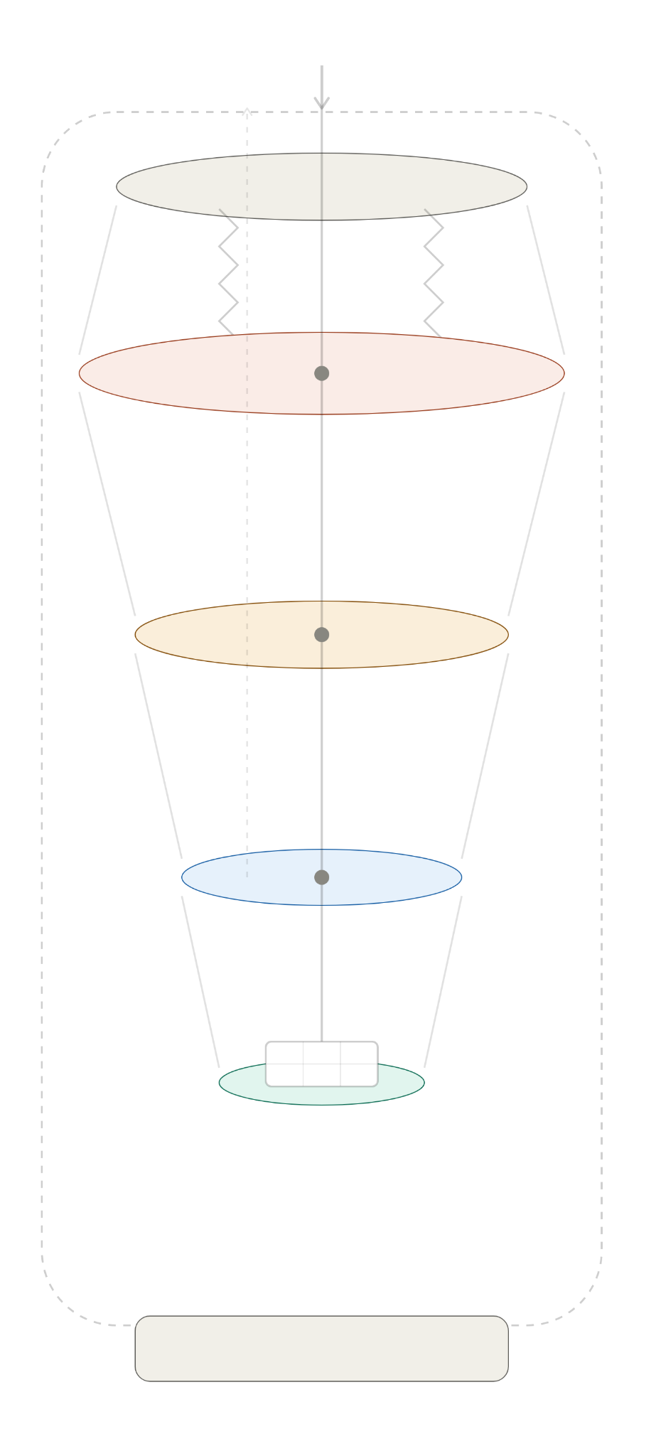
Hardware: Quantum Computer Anatomy III
Although Pathfinder is brand-new, its architecture follows the general pattern of superconducting circuit designs
Bluefors Dilution Refrigerator (cryosystem w/ temps ≤ 10 mK)
Quantum Processing Unit (QPU)
20 Qubits
Couplers
Control and Flux Lines
Connected to HPC systems via a test bed
We’ll break this down in a minute

Slide 36
Hardware: How Gates Physically Exist
In classical computers, logic gates are physical circuits, controlled by transistors
However, quantum computers treat their gates differently
Qubits can still be represented physically like we saw in the different models, but …
Gates are applied via microwave pulses (specific to superconducting circuits)
They can also take the form of
lasers (Trapped Ion + Neutral Atoms)
or
electrical pulses (other QC designs)
These instructions begin as a script, are ‘transpiled’ into hardware instructions from a framework like Qiskit, and mapped to a series of microwave pulses

Slide 37
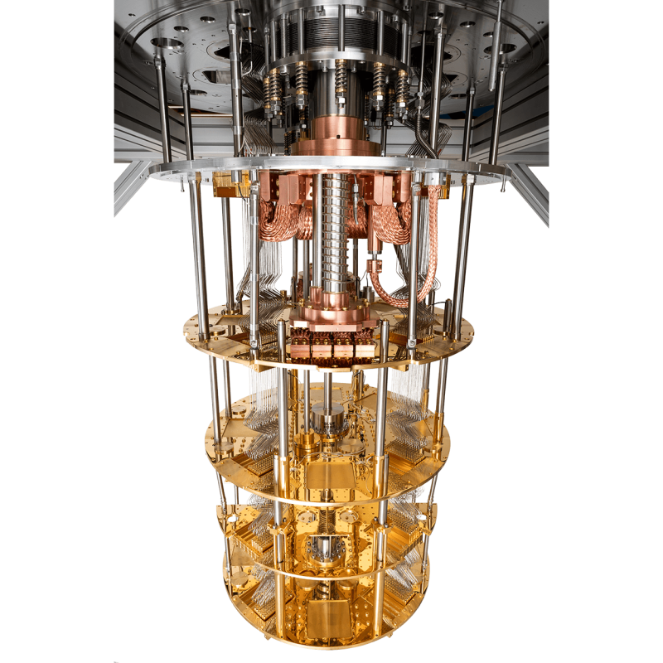
Hardware: Cooling Systems I
The Bluefors cryosystem is a gas-driven cooling system and essential for Pathfinder’s qubits to work properly
Room temperature = ~300 K
First, helium compressors chill the entire system to 4 K
Simultaneously, a second gas-handling cooling loop further reduces the internal temperature to ≤ 10 mK
Such a frigid environment is necessary to keep qubits in their fragile quantum states
Otherwise, these computers lose lots of information
Notes:
10 mK is 270 times colder than deep space

Slide 38
Hardware: Cooling Systems II
Dilution Refrigerator
Mounting Plate + Support Springs
Initial Cooling Stage:
Temp of 4K
Intermediate Cooling Stage
Isolators + Filters + Amplifiers
Final Cooling Stage:
Houses chip
Temps ≤ 10 mK
Encasing + Bottom Plate

Slide 39
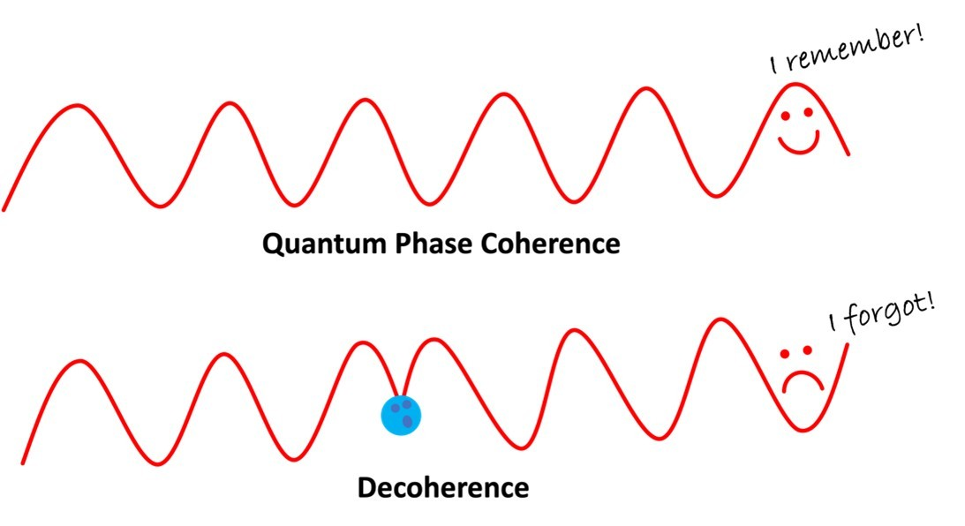
Noise: Decoherence
Decoherence - When a qubit’s superposition breaks
=> Loses quantum information
Why does this happen?
Quantum states are quite delicate and can easily destabilize
Any noise will lead to interrupting a qubit’s superposition and its entangled counterparts, breaking the entire system
Decoherence could mean a bit flip, phase flip, or some piece of corrupted info
One of the major roadblocks when scaling up in terms of qubits

Slide 40
Noise: Sources
What makes decoherence such an obstacle?
Heat
Vibrations
Electromagnetic interference
Material Defects
Background radiation
Cosmic rays

Slide 41
Noise: Error Correction
Error Correction = Techniques used to protect against noise and identify errors
Proposed Solutions:
A quantum computer with many physical qubits for every 1 reliable logical qubit
Pros: One extremely reliable computer (in theory)
Cons: Would take 100s of qubits just to handle error correction
Build noisy intermediate-scale quantum (NISQ) computers
Pros: New, more reliable algorithms
Cons: Not generalizable or scalable
Find a new physical representation of qubits
Pros: Quantum states may become more stable
Cons: Some of these particles may be purely theoretical or years off

Slide 42
Classical vs. Quantum Computers
Category | Classical Computers | Quantum Computers
Basic Unit | Deterministic Bits (0 or 1) | Probabilistic Qubits (|0> and |1>)
Core Hardware | Silicon transistors and CPUs | Qubits via superconducting circuits, trapped-ion, or neutral-atom systems
Error Rates | Very low and highly stable | Currently high due to noise and decoherence
Operating Temp | Near room temperature | Typically near absolute zero (0 K)
Cost | Affordable for consumers and enterprises | Extremely expensive specialized infrastructure
Best Use Cases | Web applications, gaming, databases, & AI training | Molecular simulation, optimization, cryptography, quantum machine learning, and materials science
Current State | Fully mature mainstream technology | Early-stage NISQ-era technology

Slide 43
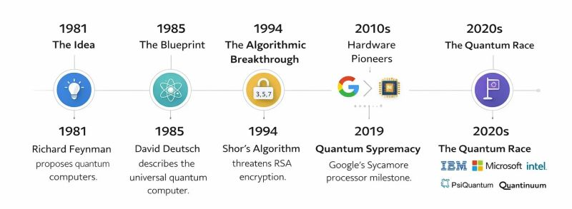
Quantum Computing Timeline

Slide 44
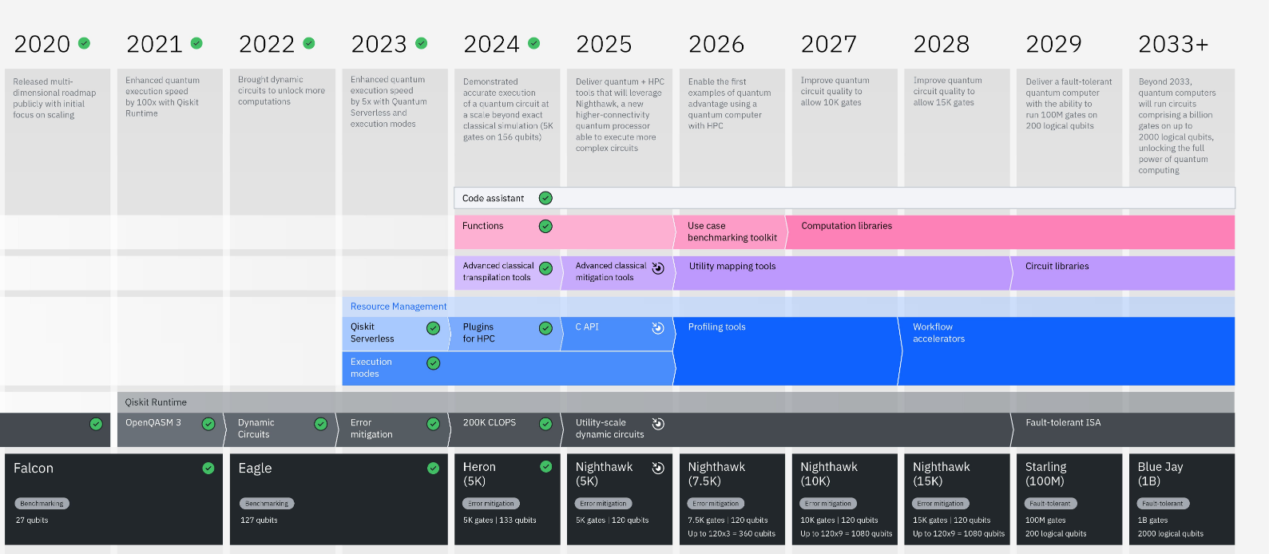
Quantum Computing Timeline
IBM Roadmap
We’ve barely scratched the surface yet

Slide 45
Resources
Quantum Computing vs. Classical Computing
ORNL Deploys IQM Pathfinder
AWS: Noise in Quantum Computing
Quantum Gates + Circuits
How Does a Quantum Computer Work?
CalTech’s Quantum Computer

